Slide 1
HOI Training
Directorate of School Education
Kashmir

Slide 2
Academic Planner
A readymade reference for School Activities that includes both Academic & Co-Curricular Activities for engagement of Children
A document that reflects Philosophy behind School
A document that guides teachers about the methods of Teaching Learning right from ECCE stage to Elementary Stage.
A document to Track and Assess Learning Outcomes of the Child.
Information about School Working Days
Information about Periodical Assessments in School.
Curriculum Tracking
Remedial Education.
Community & Parent Involvement.
Accountability of Teachers & Students
Emphasis on value based Education.
To Educate Students by celebrating Important days.
School Clubs
School Houses for Discipline , Punctuality & School Ownership of Child
School Grading based on the Performance of Schools (School Performance Index).
Felicitating Performing Schools & Supporting low performers

Slide 3
Some Recommendations
Teacher’s Manual for ECCE & Early Grades”
Consultation of “Learning Outcomes” document
The Number of working days w.e.f 15th November 2019 to 31st October 2020 shall be 210 days (Right To Education complaint) excluding Winter break, summer break & other scheduled holidays.
Commencement of Academic Activities w.e.f 15th of November from Class 1st to 9th

Slide 4
Assessment Schedule year 2020
Unit I Assessment w.e.f 9th March 2020
Unit II Assessment w.e.f 25th April 2020
Term I Examination w.e.f 2nd week of June 2020
U III Assessment w.e.f 1st week of August 2020
Term I Examination w.e.f 2nd week of October 2020
Declaration of Result/Progress Day on 25th October 2020
New Classification w.e.f 1st week of November 2020

Slide 5
Opportunity Days
Teaching of Term & Unit Syllabus | No. Of Teaching Days (Opportunity Days)
U-1 | 38 Days
U-2 | 37 Days
T-1 | 43 Days
U-3 | 38 Days
T-2 | 54 days
Total No. of Days | 210 Days (RTE Compliant)

Slide 6
Progress Day/Result day
In order to keep the parents abreast with the performance of children, the cumulative record cards duly prepared should be provided to the parents on the day of result. The day should be celebrated as the Progress day in every school where the parents, community members should be invited to share their views.
The programme of Progress Day should be personally monitored by DRGs, ,ZEOs Cluster Heads, DIET faculty and Chief Education Officers.
They shall also formulate a reformative plan for low performing students with due involvement of concerned teachers.
On the penultimate day of opening of school, a meeting of all stakeholders including VECs, SMCs, PRIs (around 15 people) to be convened to formulate Institutional Plan with explicit Learning goals for the forthcoming session. The same be shared with concerned ZEOs, Principals & Cluster Heads, DIET Principals & CEOs

Slide 7
Practical Work, Remediation &
Co-Curricular Activities
The practical /Project Work of Secondary & Higher Secondary should also be distributed evenly Unit/Term-Wise. The Practical /Project Work must be a mandatory exercise for the students of Secondary & Higher Secondary Schools and should be countersigned by the Head of the Institution after every Unit/Term Test.
In case it seems that the syllabus transaction targets are missed by any teacher/s, the extra morning and evening classes for the subject/s should be started at once.
Since the sole purpose of teaching learning is to make a student understand and built his/her capacity besides giving skills, therefore the remediation must concurrently run with the class work.
In case of Potential learners having huge learning gaps, separate Remedial Classes should be started at the beginning of the academic year during mornings or evenings.
Every week, there should be some Co-Curricular activity in the second half of each Saturday like sports, debates, Quiz, Seminars etc., These activities should collate with the curriculum to make the core academics more attractive and joyful.

Slide 8
PTAs, Pace Setting, Knowledge Register Moral Education & Sports Events
Parent Teacher Association (PTA) meet must be conducted once in a month (3rd working day of month) to restore public faith in the system and to have a feedback. Same Way VEC/SMC meeting to be conducted monthly.
After every two months, there should be outing for the students (with due permission from authorities) to have subject related tours to the University Campus, Archaeological sites Industrial areas, historical places, Botanical gardens and Museums, Fish Farms, Wildlife Sanctuaries, Nature study, local places of interest etc., the dates& destinations for which should be notified by the school authorities at the beginning of the session for entire academic session. Further, in order to give exposure to the students, some special visits should be planned to Hospitals, Post Offices, Banks, other establishments and local artisans to capture their working. Also Girl students should be especially made to interact with lady doctors, engineers, artisans, bankers and other officers for their inspiration.
Eminent Community leaders, Litterateurs, famous persons, experienced local octogenarians/older citizens to be invited to schools for interactions with the children to collect the legacy from them and gain from their experiences of life. The experience shared by them must be recorded in the register to be specifically kept for the purpose under the name of “Knowledge Register”.

Slide 9
PTAs, Pace Setting, Knowledge Register Moral Education & Sports Events
Attendance of students should be seriously made obligatory to strengthen the school system; if possible, option of Bio-Metric Attendance for students of High & Higher Secondary Schools may be practised.
Attendance of students for Practical Work in Higher Secondary Schools should be at least done through the Bio-Metric Attendance System with proper arrival and departure time. Marks for the attendance (in practical classes) should be awarded as per the actual attendance.
Emphasis on Moral Education: Morning Assemblies to be tapped for imparting Moral Education by means of Stories on Moral Education, participation of Students in different activities reflecting Morals. Also Morals should be taught across curriculum i.e., teaching of Moral Education through Academic subjects and above all Teacher being a role model should reflect Morals so that students catch the reflection.
Sports events: The Schools should frame sports activity calendar after due consultation with Department of Youth Service & Sports

Slide 10
Calendar of Activities
Consult Planner

Slide 11
Suggestive School Clubs
Eco Club: For Environmental Concerns like Environmental degradation, conservation of natural resources, biodiversity & its conservation, Herbal Gardens. Awareness campaigns, Wildlife.
The activities can include Nature Walks, Maintenance of Herbal Gardens
Sports Club: Promotion of sports especially non-conventional & indigenous sports like Javelin throw, Discuss throw, High Jump ,Long Jump, Race, Hopscotch (Vern: Sazlong) ,Santooli (vern; Kulgarm) ,Gilli Danda.
Adventure Club: Promoting adventure sports Rafting, River Crossing, Mountaineering, Snow tubing, Tracking, Cycling, Road safety and Visits to Forests
Science Club: For Science Popularisation & allied activities, botanical tours, Tours to Wild Life Sanctuaries ,National parks, Museums
Culture,Art & Heritage Club: For Preservation of Culture & Heritage and promotion of Art & Craft.

Slide 12
Suggestive School Clubs
Social Activity Club: For promoting Social Activism among students.
Counselling Clubs: Career counselling for different career opportunities for students, legal counselling, Psychological Counselling etc., Counselling on Drug de-addiction.
Health & Hygiene Club: School Hygiene conducting Health Check-ups and related activities in collaboration with Department of Health, MDM.
School Safety & Disaster Management Club: Safe Learning, Care & Protection related laws ,spelling out Standard Operating Procedures (SOPs),Safe School Environment(Infrastructural & Psychological) , Prevention of Child Abuse, Transportation issues ,Positive discipline ,Disaster Preparedness,
Legal & Electoral Literacy Club:- Club for Legal and Electoral Awareness, Adult Franchise etc.,

Slide 13
More Activities
Houses:-As this practice is in vogue in most of the schools, every School shall comprise of 4 ‘houses’ among which all the students and staff of the school would be equally divided. The names of the houses be designated on the basis of heritage,Sufi saints, Poets, Prominent Rivers, Flowers, Great Personalities etc., Students shall be nominated as House Captain, House Vice-Captain and would carry badges for the academic year. These houses shall rotate their work on weekly basis. Points shall be added/ deducted from the house tally on weekly basis according to the performance of the house in organising Morning assembly & School discipline. Felicitations of houses should be done.
ANNUAL DAY:- Celebration of Annual Day by all schools particularly High and Higher Secondary Schools shall be mandatory, for which dates shall be notified in advance and shall be cerebrated before annual examination.

Slide 14
School of the year
At the end of every academic session one of the Elementary Schools shall be judged as the ‘School of the Year’ at Zonal, District& Divisional Level based on School Performance Index (SPI) which will be based on online Academic Monitoring of different subjects strictly according to the “Learning Outcomes” document of NCERT/Samagra Shiksha and School Academic Processes Tracker. The SPI will further include indicators on Implementation of ECCE, Student’s attendance, Teacher attendance, effectiveness of Remedial Classes, minutes, decisions & their implementation in Parent Teacher Association (PTA) meetings and Knowledge Register maintenance.
The online monitoring and the punching of results will help us to generate school results (SPI) besides capturing of other indicators with respect to this Academic Planner and subsequently the schools will accordingly be graded into
Green (Schools where learning levels & other parameters are good).
Yellow (Schools where learning levels & other parameters are average).
Red (Schools where learning levels & other parameters below average).

Slide 15
Online Academic Monitoring

Slide 16
Online Academic Monitoring & School Tracking system using Google Docs through a network of DRGs, ZRPs and CRPs-Learning Level Assessments (Elementary)
As mentioned in Academic Planner, School Performance Index (SPI) which reflects Children Engagement ,School Activities and Learning Levels as per Learning Outcomes ,an online Academic Assessment & School Processes Tracker (Assessment Tool) has been formulated.
Team DRGs ,ZRPs & CRPs visit elementary schools and apply this Assessment Tool in these Schools.
The School Processes are punched online on Mobile Phone in App/Google Doc in assessment tool .
We get Real-time capture of School Performance Index – a snapshot of District-wise, Zone-wise and School wise performance of Children & School.

Slide 17
Online Academic Monitoring & School Tracking system using Google Docs through a network of DRGs, ZRPs and CRPs-Learning Level Assessments (Elementary)
Concerned ZEO shares the School Performance Reports with Headmasters in the Monthly Meeting and reflects accordingly.
ZRPs/CRPs/DRGs render on site Academic support to the schools based on the outcomes of the school.
CEO/DIET Principal holds Monthly review ZEOs on the School Performance of his/her Zone.
DSEK team/SIE review CEOs/Principal DIETs on the school performance of their districts.
School Grading is done and the performing schools to are felicitated and under performers are given special focussed upon.

Slide 18
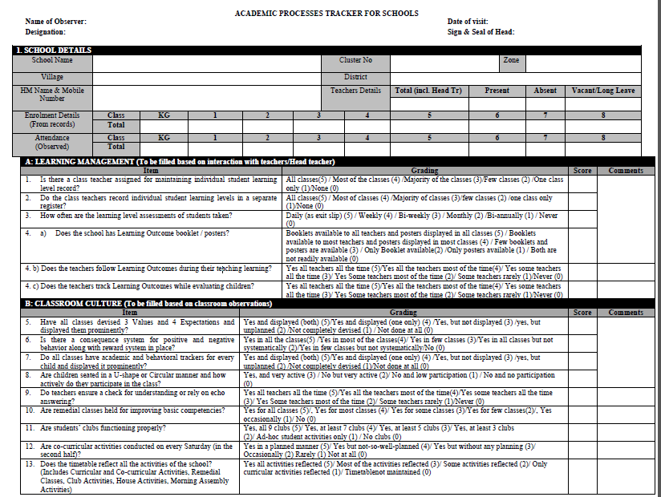
School Academic Tracker

Slide 19
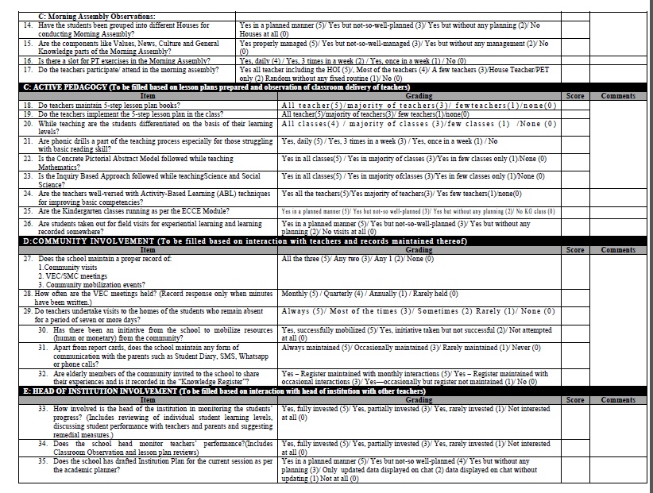
School Academic Tracker-Continued

Slide 20
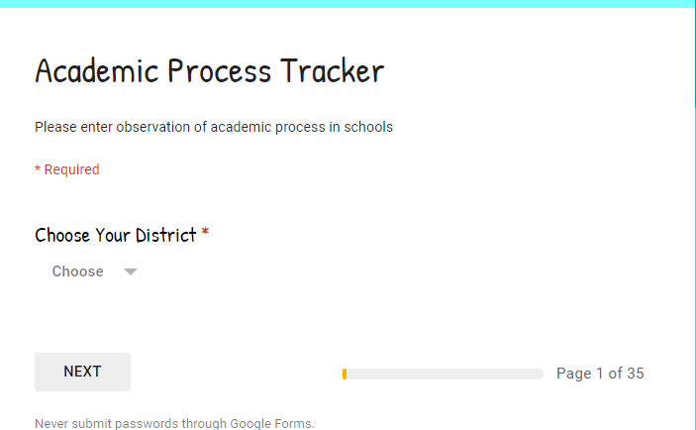

Slide 21
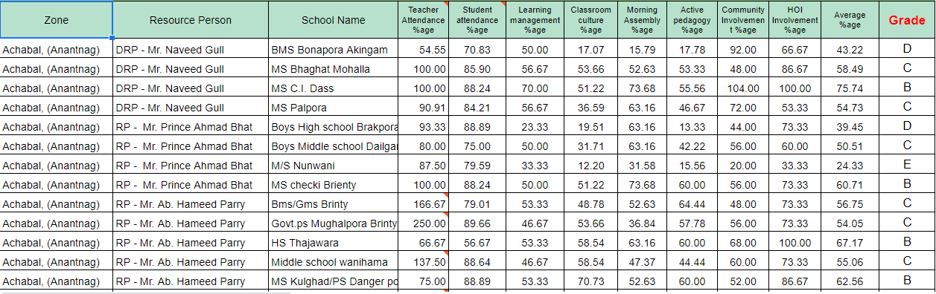
School Report

Slide 22
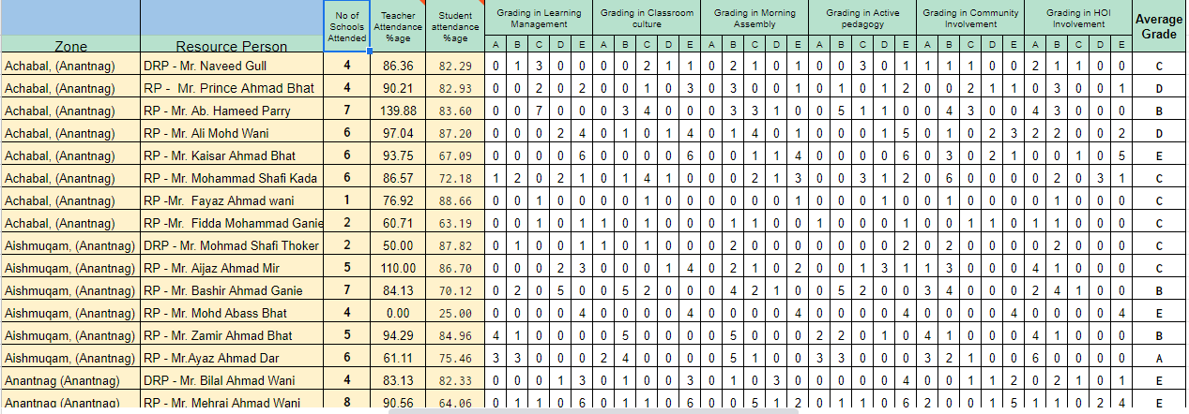
Resource Person wise Report

Slide 23
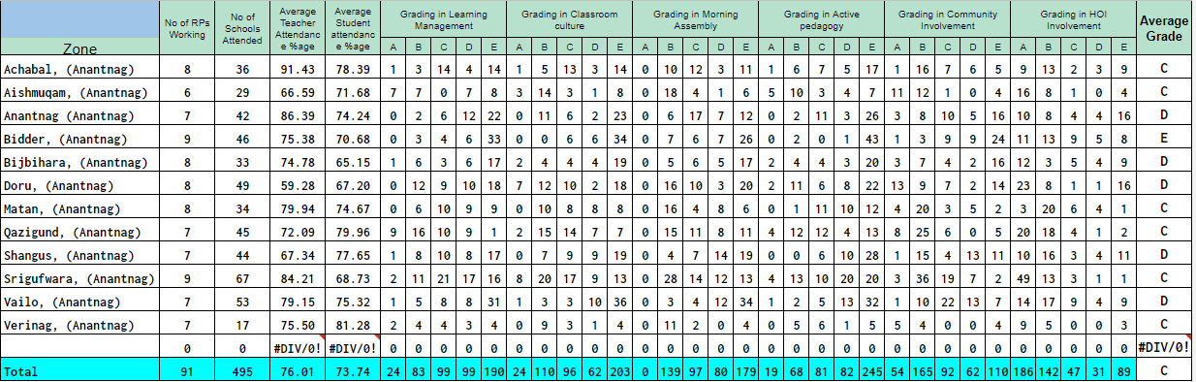
Zonal Report

Slide 24
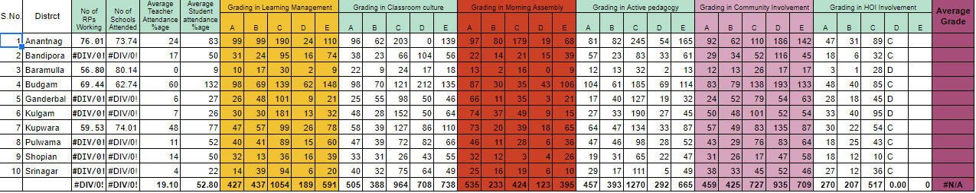
District/Divisional Report

Slide 25
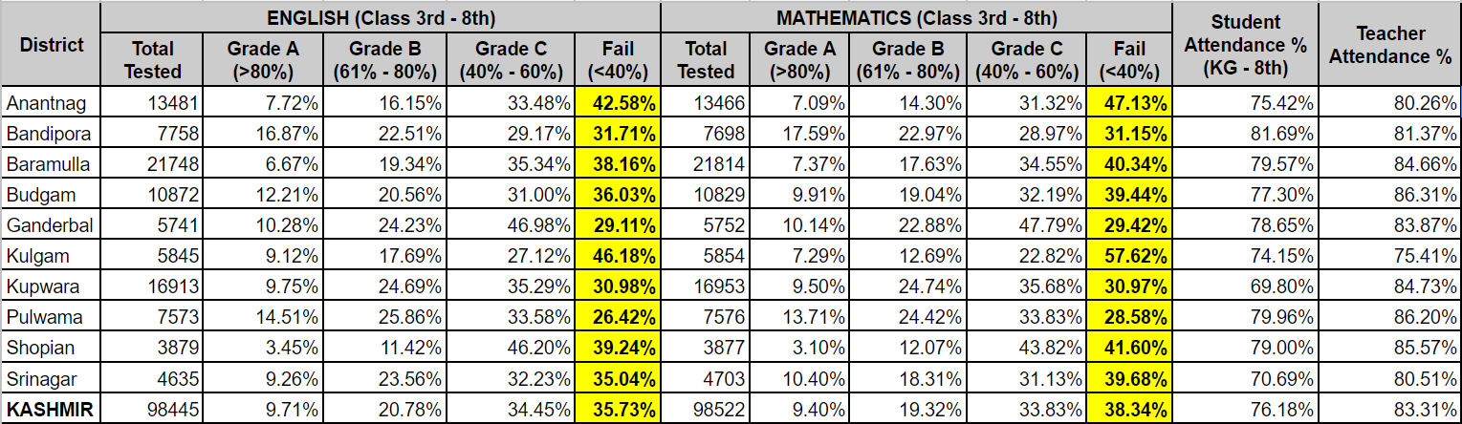
Snapshot of District Level Child Performance

Slide 26
Provision of Assured Minimum Facilities

Slide 27
Drinking Water facility
Indicators | Present Status | Action Steps to be taken | Who to do it? | Timeline
Source of drinking water facility
Process of purification of drinking water in school
Availability of Drinking water in the school
Whether Drinking water is stored in overhead tank/s
Number of times overhead tank/s were cleaned during the current year.
Cleanliness around drinking water facilities is done:

Slide 28
Toilet Facility
Indicators | Present Status | Action Steps to be taken | Who to do it? | Timeline
Total number of toilets available
Number of functional toilets for Boys
Number of functional toilets for Girls
Number of functional toilets for CWSN
Number of functional toilets for Staff
Urinals available for boys
Availability of water for flushing and cleaning of toilets
Cleaning of toilet
Availability of soap for hand washing
Mechanism for sanitation and cleanliness of toilets
Availability of dustbin, bucket, mug etc.
Hinge Lock
Pink colour for Girls toilet

Slide 29
Beautification of School & Surroundings
Indicators | Present Status | Action Steps to be taken | Who to do it? | Timeline
Availability of playground
Boundary wall
Levelling of ground
Maintenance of ground
Arrangement for outdoor games
Beautification of lawn

Slide 30
Classroom Environment
Indicators | Present Status | Action Steps to be taken | Who to do it? | Timeline
Space
Heating
Cooling
Lighting
Matting
Blackboard/Furniture
Seating Arrangement
Learning Corners
Display of Students

Slide 31
Kitchen Shed
Indicators | Present Status | Action Steps to be taken | Who to do it? | Timeline
Availability of Kitchen Shed
Availability of water
Drainage facility
Cleanliness
Adequate and sufficient Utensils
Storage Bins

Slide 32
Ramp facility
Indicators | Present Status | Action Steps to be taken | Who to do it? | Timeline
Availability of Ramps for all building & toilet block
Whether slope of the Ramp is as per the 1: 12 ratio
Present condition of Ramp
Whether Ramp is usable in
All weather conditions

Slide 33
Electricity and Gadgets
Indicators | Present Status | Action Steps to be taken | Who to do it? | Timeline
Whether all rooms have adequate electric lights and fans.
Wiring, lights, fans and switch boards are in good condition.
Is back-up facility for power failure?( Generator)
Whether MCB are in place to prevent fire due to short circuit.
Whether electric fitting and appliances are safely installed in order to ensure safety of students.
In case of fire/emergency/natural calamity whether school has a proper evacuation plan for students’ / safe exit.

Slide 34
Institutional Planning
SWOT Analysis
School Details
Instructional Days
Academic Year Details
Human Resource Details
Club Details
Annual Activity Calendar
School Infrastructure
School Mapping & School Improvement Plan
Financial Aspects
Major Achievements
General Guidelines

Slide 35
Framework for Institutional Plan
SWOT Analysis
Institutional plan refers to a plan which helps us to know the institution, its strengths & weaknesses. It is a statement of intentions which reflect the school’s vision for the academic session in general & future of the institution in particular.
The process involves reaching agreement on a sensible set of priorities for the school and then taking action to realize the plan.
A good institutional plan should result in enhanced quality of performance of school & its students.
It should be in tune with Academic Planner of DSEK and should aim to track the Planner in School

Slide 36
General Instructions
1. The role of Institutional plan is to fill the vacuum in the current understanding of education systems and provide the basis for further educational development.
2. Understanding the vision, mission and goals of an institution in the planning process.
3. Become aware of different plans and organizing skills required as a school teacher and head of the institution.
4. Develop an insight into the responsibilities and the leader in professional growth, commitment, competencies, attitudes, school development plan, physical and human resource management, time management and community relations.
5. Train the teachers and head teachers in planning and executing the curricular and co-curricular programmes of the school.
6. Adopt ICT in the process of Planning and Organization of school activities.
7. Understand the needs of alternative education and integrate it into the curriculum.
8. Develop in the student and teachers the classroom management skills.
9. Prepare the student & teachers in using different tools and techniques for continuous and comprehensive evaluation.
10. This framework is only suggestive. The schools can alter it as per their local context and needs.

Slide 37
School Details
1.Brief historical development of the Institution (with Geography of the surrounding area):
2. Objectives of the Institution (Specific only):
3. School Particulars:
I. School Name:
II. UDISE Code:
III. Rural / Urban
IV. Village & Habitation Name
V. Pin Code
VI. Municipal Ward No
VII. Educational Zone
VIII. Name of Cluster
IX. Assembly Constituency
X. Revenue Block
XI. Year of Establishment
XII. Distance in KMs from: CEO Office: _________, DIET:_________, SIE/SPD office________, DSEK: ___________, Public Library: ________, Police Station: __________, Fire Service: ______
XIII. No. of staff members:____________ (Male ____/Female____)
(Masters_____, Teachers___________, Lecturers_________)
Whether Head of the institution is in place. (Yes/No)__________, if No mention the name and designation of in charge HOI.

Slide 38
Instructional Days
Total number of instructional days during the last academic session
Stage | Primary | Upper Primary | Secondary | Higher Secondary
No. of Days
Remarks
Primary | Elementary | Secondary | Higher Secondary

Slide 39
Academic Year Details (Previous Year)
Classes | Pre- Primary |  | I |  | II |  | III |  | IV |  |  | V |  | VI |  | VII |  | VIII |  | IX |  | X |  |  | XI |  | XII
 | Boys | Girls | B | G | B | G | B | G | B | G | B |  | G | B | G | B | G | B | G | B | G |  | B | G | B | G | B | G
General
SC
ST
OBC
CWSN
Total

Slide 40
Academic Year Details (Current Year)
Classes | Pre- Primary |  | I |  | II |  | III |  | IV |  |  | V |  | VI |  | VII |  | VIII |  | IX |  | X |  |  | XI |  | XII
 | Boys | Girls | B | G | B | G | B | G | B | G | B |  | G | B | G | B | G | B | G | B | G |  | B | G | B | G | B | G
General
SC
ST
OBC
CWSN
Total

Slide 41
Human Resource Available (Faculty Profile)
S. No. | Name of the Principal/ Headmaster/ Lecturer/ Master/ Teacher/ | Academic Qualification | Professional Qualification | Diploma / Certificates | Years of Experience | Remarks
1
2
3
4
5
6
7
8
9
10

Slide 42
Formation of Clubs with Member List
Health & Hygiene | Sports | Discipline | Science | Social Activities | Eco Club | Counselling Clubs | Culture ,Art & Heritage | School safety & Disaster Management | Other Clubs (please Specify)

Slide 43
Annual Activities Calendar
S. No. | Month | Day & Date | Name of the Activity/Activities | Plan of Action
1 | January
2 | February
3 | March
4 | April
5 | May
6 | June
7 | July
8 | August
9 | September
10 | October
11 | November
12 | December

Slide 44
School Infrastructure
School Layout (Complete Drawing of School Campus, including Building, Playground etc)
S. No. | Name | No./Qty/ | Remarks
1 | Building
2 | Classrooms
3 | Seating Desks
4 | Lecture Hall Big with Capacity
5 | Computer Lab.
6 | Library
7 | No. of Books in the Library
8 | Playground
9 | Internet (Broadband)
10 | Notice Board
11 | Sign Board

Slide 45
Draft Tool for School Improvement Plan
School environment
Indicators | Present status | Action/steps to be taken | Responsibility | Timeline
Water, sanitation & toilet facilities
Security, cleanliness & health (first aid)
Beautification of schools & surroundings
Psychosocial atmosphere and inclusion
Mid-Day Meals (without disrupting learning activities)

Slide 46
Draft Tool for School Improvement Plan
Classroom environment
Indicators | Present status | Action/steps to be taken | Responsibility | Timeline
Space,
lighting
cooling/heating
Mats, furniture, (seating arrangement)
Blackboards, Wall cement-Boards
Learning Corners
Display of students’ work

Slide 47
Draft Tool for School Improvement Plan
Enrolment and attendance
Indicators | Present status | Action/steps to be taken | Responsibility | Timeline
Regular attendance & participation of all children
Regular attendance by teachers
Punctuality of Students
Punctuality of Teachers

Slide 48
Draft Tool for School Improvement Plan
Teaching Learning Process
Indicators | Present status | Action/steps to be taken | Responsibility | Timeline
Active classroom processes
Learning linked to environment
Continuous & stress-free assessment
home activities

Slide 49
Draft Tool for School Improvement Plan
Students’ Learning
Indicators | Present status | Action/steps to be taken | Responsibility | Timeline
% of low-achieving students
Students’ learning difficulties in each subject
Physical, recreational & creative activities

Slide 50
Draft Tool for School Improvement Plan
Community Involvement
Indicators | Present status | Action/steps to be taken | Responsibility | Timeline
Active participation of School Management Committee (Meetings)
Involvement of Community in quality improvement
Involvement of Community in monitoring (% attendance in meetings)

Slide 51
Financial Aspects Source/s of Fund/s: (Tick)
S. No | DSEK | SPD | Local Fund | MLA | Deputy Commissioner | Session Judge | Sports Authority | Corporate Social Responsibility | Other Donations

Slide 52
Major Achievements Awards
i). Academic Awards Description: ____________________________________________
ii). Sports Awards: ____________________________________________
iii). Cultural Awards: ____________________________________________
iv). Any other : ____________________________________________

Slide 53
Lesson Planning
5-E Lesson Plan
Engage
Explore
Elaborate
Explain
Evaluate

Slide 54
4C Lesson Plan
Consider
Construct
Consolidate
Clarify

Slide 55
Constructivist Lesson Plan
5E
1. Engage:
  Activities which focus learner’s attention.
  Harness previous knowledge
  Provides students the reason to explore

Slide 56
Constructivist Lesson Plan
5E
2. Explore:
  Phenomena are explored
  Hands on activities
  Activities that give learners time to think, investigate, reflect, test, decide, solve and collect information.

Slide 57
Constructivist Lesson Plan
5E
3. Explain:
  Activities that allow students to analyse in 3 ways:
    1. students are given opportunity to formalise and share the understanding had in the explore phase
    2. teachers use the students explanations and refine the learner’s conceptual understanding by directing attention to important elements.
    3. teachers pose higher order questions

Slide 58
Constructivist Lesson Plan
5E
4. Elaborate:
    Here activities allow students to apply concepts and build or extend their understanding and skills to the real world situations.
    Students develop good understanding of the concept.

Slide 59
Constructivist Lesson Plan
5E
5. Evaluate:
    Students demonstrate what they have understood/learnt.
    Summative assessment given here.

Slide 60
Constructivist Lesson Plan
4C
 | Lesson Transition | Teacher Mediation (Teacher mediation level) | Resource Mediation (Resource mediation level) | Learner motivation & Cognition level
1 | Consider | Demonstrate/show/model Brief/explain/ Answer/clarify/define/direct Prompting questions/hints/approval/no Watch/see/check | Working model/outing Static model/specimen Video Pic/chart text | The learner: Listens Watches questions Observes Reflects Answers Explains Reads Discusses Shows Uses Enquires

Slide 61
Constructivist Lesson Plan
4C
 | Lesson transition | Teacher Mediation (Teacher mediation level) | Resource Mediation (Resource mediation level) | Learner motivation & Cognition level
2 | Construct | Brief/explain/ Answer/clarify/define/direct Prompting questions/hints/approaval/no Watch/see/check | Working model/outing Static model/specimen Video Pic/chart text | The learner: Reflects Analyses discusses Reads Writes Makes Shows Uses questions Enquires

Slide 62
Constructivist Lesson Plan
4C
 | Lesson transition | Teacher Mediation (Teacher mediation level) | Resource Mediation (Resource mediation level) | Learner motivation & Cognition level
3 | Consolidate | Brief/explain/ Answer/clarify/define/direct Prompting questions/hints/approaval/no Watch/see/check | Working model/outing Static model/specimen Video Pic/chart text | The learner: Reflects Analyses discusses infers summarises Relates Reviews Applies Extends

Slide 63
Constructivist Lesson Plan
4C
 | Lesson transition | Teacher Mediation (Teacher mediation level) | Resource Mediation (Resource mediation level) | Learner motivation & Cognition level
4 | Clarify | questions/hints/approve/no Watch/see/check | Working model/outing Static model/specimen Video Pic/chart text | The learner: Articulates Explains States Writes Answers Demonstrates Asserts

Slide 64
Remediation for Bridging Learning Gaps of previous Academic year
Gap Analysis (lost out part) of Curriculum taught in Previous session keeping track of competencies & skills
Formulation of Remedial Plan
Integration of Lesson Plan in School Time Table.
Time line for the execution of Remedial Plan.

Slide 65
School Management

Slide 66
Aspects
Target fixing for teachers vis-a-vis benchmarks given.
Required TLE/TLM and other enabling conditions for the teachers and the children.
Involvement of all the stake holders in the decision making

Slide 67
Contd.
Teachers: Subject choices, Time choices ,Specific curricular/extra curricular fields.
Parents: Choices regarding home work, weaknesses of their wards, behavioral problems of their children, physical/mental problems of their children, problems faced at the school, in the society.
Children: Choices about subjects and related fields, input about teachers, uniforms, time table ,quality of text books,requirements in the class-room etc.

Slide 68
Contd.
Arrangement of co-curricular and extra curricular activities.
Proper utilization of resources by way of Kits, TLE and TLM tems.
Proper arrangements of special focus groups-Girls/SC&ST children/CWSN.
Convergence with other organizations for the provisioning of the basic facilities.
Training needs of teachers as per the actual class room problems.
Action Researches/Case studies on poor participation and learning problems.

Slide 69
Contd.
Implementation of CCE.
Target for mainstreaming of OOSC with participation from community.
Target for educational attainment of children with respect to development of competencies.
Comparison of educational attainment with other schools, of different years, of different groups, of different sexes, of different communities.

Slide 70
Indicators of Participation
GER/NER/RETENTION RATE/DO RATE/TRANSITION RATE/REPETITION RATE.
Analysis of examination results.

Slide 71
HUMAN RESOURCE MANAGEMENT
Sharing of human resources.
Professional development of teachers.
Match between qualification and specialization with the subjects assigned.
Meetings with teachers for sharing the class room experiences and for spelling out hard spots.
Creation of enabling conditions for the teachers.

Slide 72
Contd.
Apportioning of right jobs for the right persons-teacher
Rationalization of different assignments.

Slide 73
Financial Resource Management.
Sources of Financial Resources:
Plan and Non Plan Funds.
Funding pattern of CSS.
Recurring and Non-Recurring grants.
Non recurring grants get spilt over while as recurring grants get lapsed after the year these stand released for.
Utilization of grants as per the specific uses.

Slide 74
Contd.
Maintenance of account books:
Central Cash book.
Cash books of different interventions.
Bank reconciliation statements.
Stock book.
Involvement of the community.
Enrolment with respect to MDMP, Books, Scholarships etc.
Physical balance and book balance of MDMP.

Slide 75
Physical resource Management.
Campus plan.
Monitoring of Civil Works.
Planned up-gradation of infrastructure.
Asset files/record of available land with updated revenue extracts.
Mutation of school land in the name of the DE.
Boundary determination.
Convergence with different organizations.

Slide 76
Administrative Management.
Regulation of attendance.
Proper utilization of time.
Maintenance of discipline/order.
Involvement of stake holders in informed decision making.
Linear principle.
Projection of problems in the right perspective.
Conduct of meetings with the parents/stake holders.
Effective implementation of programmes/policies/schemes.
Responsiveness to directives.

Slide 77
Accountability/Punctuality
(Geo-Tagging ,Biometric)
An initiative of online attendance in schools by teachers.
Location of teacher in school ,his/physical presence and the school reporting time is tracked.
The report is automatically generated in DSEK.
The facility of Feedback SMS from DSEK to schools is also included.
The intervention has been piloted in all Districts to begin with. All the schools of the Kashmir Division will be brought under this intervention in a phased manner

Slide 78
THANK YOU

